Slide 1
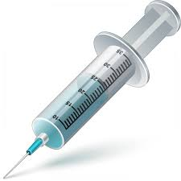

High Level CRP Flow Diagram
INTERCEPTOR
INTERCEPTOR
REQUEST
PROCESSOR
TRANSFORMER
TRANSFORMER
Inbound
Outbound

